Slide 1
Module 5 -3

Slide 2
In-Memory Databases and SSDs
In-Memory Databases
This is where the active processing happens (e.g., Redis, SAP HANA, Spark).
Speed: Data is stored in RAM, which is thousands of times faster than any disk.
Latency: It provides sub-millisecond response times because there is no "mechanical" seek time.
The Catch: RAM is volatile (data vanishes if the power cuts) and expensive. You can't store everything here.

Slide 3
In-Memory Databases and SSDs
2. SSDs
SSDs (Solid State Drives) bridge the gap between volatile RAM and slow traditional hard drives.
Persistence (The Safety Net): In Redis and HANA, every "Write" is logged to an SSD. If the system crashes, the database reads the logs from the SSD to rebuild the memory state.
Spilling (The Overflow): In Spark, if a dataset is too large for the RAM, it "spills" the extra data onto the SSD. Because modern NVMe SSDs are very fast, the system keeps running without crashing.
Warm Storage: Not all data is used every second. Databases move "Warm" data (accessed once an hour) to the SSD, keeping only "Hot" data (accessed every second) in RAM. This saves money while maintaining high performance.

Slide 4
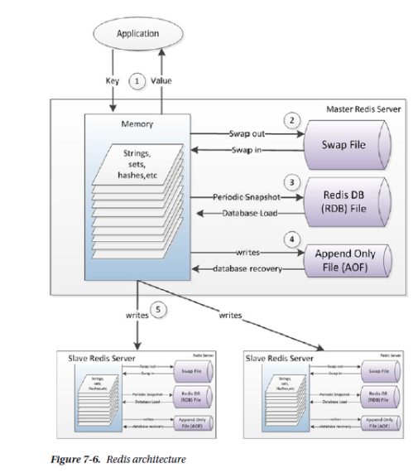
Redis architecture

Slide 5
Architectural workflow of a Redis system
1. In-Memory Data Management
Redis is an In-Memory data store.
Interaction (1)-Applications interact with Redis by sending a Key and receiving a Value. Because this happens entirely in RAM (Memory), response times are extremely fast (sub-millisecond).
Data Structures: The memory block shows that Redis supports various data types, such as Strings, Sets, Hashes, and more, rather than just simple key-value pairs.

Slide 6
Architectural workflow of a Redis system
2. Persistence Mechanisms
Because RAM is volatile (data is lost if the power goes out), Redis uses two main methods to save data to a disk:
RDB (Periodic Snapshot) (3): This creates a compact, point-in-time "snapshot" of your entire dataset at specified intervals. It is great for backups but may lose a few minutes of data if a crash occurs between snapshots.
AOF (Append Only File) (4): This logs every single Write operation as it happens. If the server restarts, it "replays" these logs to reconstruct the database. This is more durable than RDB but results in larger files.

Slide 7
Architectural workflow of a Redis system
3. Memory Overflow (Virtual Memory)
Swap File (2): This represents an older feature called "Virtual Memory" where Redis would Swap out rarely used data from RAM to a disk file to save space.
Note: This feature was deprecated years ago. In modern Redis, if you run out of RAM, the system typically uses an "eviction policy" to delete old data or simply returns an error.

Slide 8
Architectural workflow of a Redis system
4. Replication (High Availability)
Master-Slave Setup (5): To prevent a single point of failure, the Master server sends all incoming Writes to one or more Slave (now commonly called "Replica") servers.
This ensures that if the Master crashes, a Slave has an identical copy of the data and can take over. Slaves also have their own persistence files (RDB/AOF) for additional safety.

Slide 9
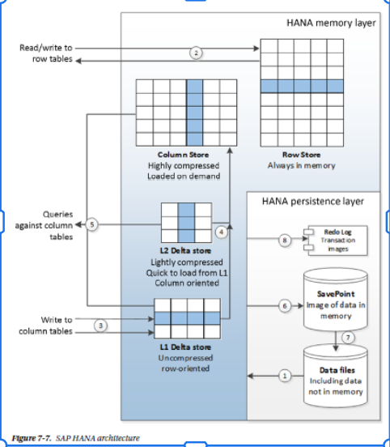
Architecture of SAP HANA

Slide 10
Architecture of SAP HANA
1. HANA Memory Layer
SAP HANA is an "In-Memory" database, meaning it keeps active data in RAM for extreme speed. It splits data into two types:
Row Store (2): Traditional database storage where data is stored in rows. This is optimized for "point queries" (looking up a specific record) and is kept always in memory.
Column Store: This is where HANA’s power lies. It stores data in columns, which is much faster for analytical queries (e.g., "Calculate total sales"). It is highly compressed and loaded into memory only when needed.

Slide 11
Architecture of SAP HANA
1. HANA Memory Layer
Delta Stores (L1 & L2): Writing directly to a highly compressed column store is slow. To fix this, HANA uses:L1 Delta (3): Captures new writes quickly in an uncompressed format.
L2 Delta (4): Periodically, data moves from L1 to L2, where it is lightly compressed before finally being merged into the main Column Store.

Slide 12
Architecture of SAP HANA
2. HANA Persistence Layer (Disk)
Even though it's an in-memory database, it must save data to a physical disk so it isn't lost if the power goes out.
Redo Log (8): Every transaction is immediately recorded here. It's the "play-by-play" history used to recover recent changes.
SavePoint (6): Every few minutes, HANA takes a "snapshot" of the data currently in memory and saves it to disk.
Data Files (1/7): These are the long-term storage files on the disk that hold the bulk of the database, including data that might not currently be loaded into RAM.

Slide 13
Architecture of SAP HANA
Reads (5): Analytical queries pull from the Column Store or the Delta stores for the most recent data.
Writes (3): New data enters through the L1 Delta store to keep the system fast.
Recovery (1): On restart, the system loads data from the Data Files and "replays" the Redo Logs to get back to the exact state it was in before the shutdown.

Slide 14
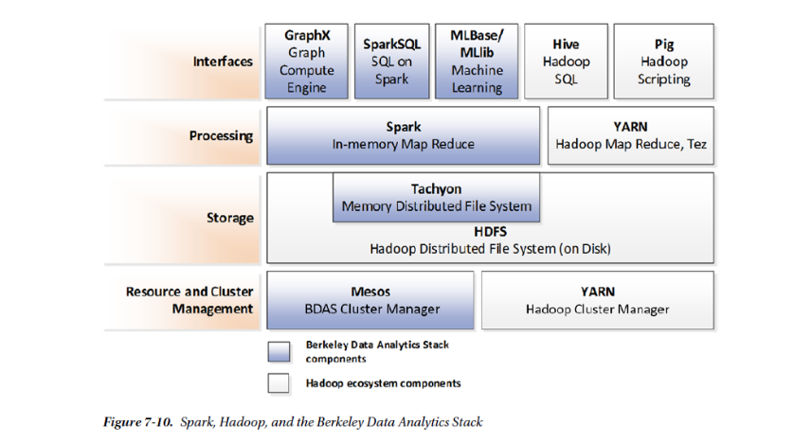
Berkeley Data Analytics Stack (BDAS) and the Hadoop ecosystem

Slide 15
Berkeley Data Analytics Stack (BDAS) and the Hadoop ecosystem
1. Interfaces (Top Layer)
These are the tools users interact with to process data:
GraphX: For graph processing (like social network analysis).
SparkSQL: Allows users to run standard SQL queries on top of Spark.
MLlib/MLbase: Used for machine learning and statistical modeling.
Hive/Pig: Traditional Hadoop tools for SQL-like querying and scripting.

Slide 16
Berkeley Data Analytics Stack (BDAS) and the Hadoop ecosystem
2. Processing (Computation)
This layer does the "heavy lifting" of data calculation:
Spark: Performs "In-memory Map Reduce," which is much faster than traditional disk-based processing because it keeps data in RAM.
YARN (MapReduce/Tez): The classic Hadoop way of processing data, which typically reads from and writes to the disk during tasks.

Slide 17
Berkeley Data Analytics Stack (BDAS) and the Hadoop ecosystem
3. Storage
Where the actual data lives:
Tachyon (now known as Alluxio): A "Memory Distributed File System." It acts as a fast, in-memory layer above the disk storage to speed up data access.
HDFS (Hadoop Distributed File System): The standard storage layer that keeps large amounts of data spread across multiple disks in a cluster.

Slide 18
Berkeley Data Analytics Stack (BDAS) and the Hadoop ecosystem
4. Resource and Cluster Management
The foundation that manages the hardware:
Mesos: A cluster manager that can run Spark and other applications.
YARN: Specifically manages resources for Hadoop-based clusters.

Slide 19
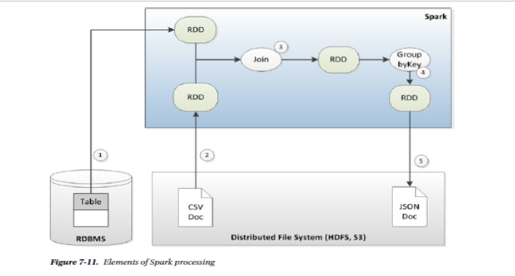
Spark Processing

Slide 20
Spark Processing
workflow of pulling data from different sources, transforming it in memory, and saving the result.
1. Data Ingestion (Input)
(1) RDBMS: Spark pulls data from a traditional relational database table.
(2) Distributed File System (HDFS, S3): Simultaneously, it pulls data from a flat file, like a CSV Doc, stored in a cloud or distributed system.
In both cases, this data is loaded into the Spark Memory Layer as RDDs.

Slide 21
Spark Processing
2. In-Memory Processing (Transformations)
Once the data is in Spark, it undergoes "Transformations" to change its shape or combine it:
(3) Join: Spark takes the two separate RDDs (one from the database and one from the CSV) and joins them together based on a common key (like a User ID). This creates a new, combined RDD.
(4) GroupByKey: The combined data is then reorganized. For example, it might group all sales records by "Region" or "Date." This produces the final processed RDD.

Slide 22
Spark Processing
3. Data Output (Action)
(5) Saving Results: Finally, the processed data is written back out to the Distributed File System, often in a different format like a JSON Doc, for use in reports or other applications.

